Slide 1
Getting Down & Dirty:
The Economic Impact & End Market Development
of Food Scrap Diversion
in Illinois
Presented by
The Illinois Food Scrap Coalition
Notes:
Jen J will introduce all
Welcome and good afternoon! Thank you for joining us for a discussion on food organics diversion.
My name is Jennifer Jarland and I am the Recycling Program Coordinator for Kane County, as well as a founding member of the Illinois Food Scrap Coalition, and secretary of IFSC’s Board of Directors.

Slide 2
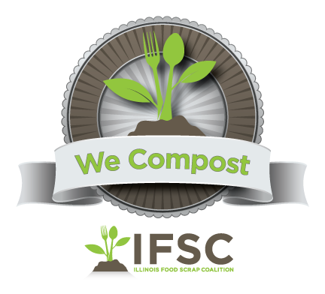
Origins & Accomplishments
2012 – Formed group
– Waste Not: Advancing Commercial Food Scrap Collection in the Chicago Area (GreenTown Highland Park)
– Letter in support of DCEO f-scrap program
2013 – Launched We Compost Program
2014 – Facilitated 5 statewide forums (DCEO) to create the Illinois Food Scrap Composting Challenges & Solutions
– Social media presence begins
2015 – Food Scrap Composting Challenges & Solutions in Illinois Report
– Policy: HB437, SB1518, HB2495, HB1362
2016 – Incorporated & convened a Board of Directors
– Began paid membership, hired Administrative Coordinator
– Strategic Planning
– Policy: HB5530
– Held four forums
2017 – Economic Impact Report & dissemination
– Market Development efforts
– Committee Work & Membership growth
– Outreach & Education
– We Compost Program expansion and mapping project
Notes:
LIZ
Hi, thanks for attending our session today. I am going to provide a brief overview of the IFSC and others on the panel will get down to the nitty gritty on economic impacts of our work diverting food scraps from landfills, and the development of markets for the finished compost.
The Illinois Food Scrap Coalition is a thriving organization of community and government organizations, businesses, schools, institutions, service providers and processors throughout the state that are dedicated to advancing food scrap composting in Illinois.
This is a small selection of our accomplishments over the last 5 years. Please see our website, under About. There you will find all of our Accomplishments listed in the annual reports.
In 2012, following a conference on the topic in DuPage, a small group of Northern IL colleagues got together at SWANCC’s office to share collective food composting initiatives, which led to the formalization of the Illinois Food Scrap Coalition (IFSC).
We’ve launched a voluntary recognition program, called We Compost, for businesses that are composting their food scraps.
We produced a report on Food Scrap Composting Challenges and Solutions after conducting a series of forums statewide.
In 2016, the group:
incorporated and formed a Board,
initiated paid membership,
hired an Administrative Coordinator (me!), and
began our first Strategic Planning process.

Slide 3
Strategic Planning Goals
Policy: permitting and siting; diversion laws; planning; government involvement
End Product: identifying markets; education; engagement; contamination; certification
Programs: We Compost; Synergy & Collaboration; food service program development (@ schools, universities, restaurants, hospitals); water quality links; establishing temporary drop-offs; data bases; measurement; mapping; establish goals; farm-based composting; Zero Waste schools; community colleges network
Education: pumpkin recycling events; case studies; legislative executive summary; alignment with complementary initiatives; events calendar; website; IFSC Composting hierarchy; tours of facilities; building awareness; articles published; conferences & events; hauler engagement; promoting route density
Notes:
LIZ
Our Strategic Planning Goals center around four main areas of focus.
Policy includes working to improve permitting and siting and diversion laws.
End Product goals look at identifying and securing end markets for composted material, among other things
Programatic goals include expanding the We Compost program, working with schools, and exploring new opportunities, as well as measurement and reporting
And we have many Educational goals as you can see. I’ll give you a moment to read through (wait…)
How do we get all of this done. you ask?!

Slide 4
Policy and Permitting
Market Development
Communications and Outreach
Education
Social Media and Website
has grown
from 8 in 2012
to
100+ in 2017
WeCompost
Membership
Notes:
LIZ
Along with the work that Seven Generations Ahead and other IFSC partners do under the Chicago Community Trust Grant, The IFSC has a bunch of very active working committees.
Membership has grown to over 100 paid members, and we meet monthly via conference call on the first Monday of the month at 12 noon. Please consider joining us.

Slide 5
Food Scrap Composting in Illinois Update
43 IEPA permitted compost processors
12-14 of these accept food scraps
127 We Compost partners
restaurants, institutions, businesses, schools and municipalities now compost food scraps
State policies enacted to support hauling and processing of food scraps
Residential 3rd cart, ride along (with yardwaste), organic dropoff (1st pumpkins and now more)
Notes:
LIZ
With 5 years of hard work, where does that leave us now?
IEPA has permitted 43 commercial compost facilities in Illinois, all of which take yard waste. Currently about a dozen of them also accept food scraps.
IFSC has a free recognition program for those restaurants, institutions, businesses, schools and municipalities that are doing commercial food scrap composting. We Compost works to share best practices and promote these businesses
And the policy committee has been busy advocating for policies supporting collection, hauling, processing and use of finished compost. Check out our website to learn more.
While we have seen an increasing demand for food scrap composting in Illinois, it is still, for the most part more expensive to compost than to landfill. To allow composting to be done at a competitive cost, we need to continue to shift policy and infrastructure, and create a market for finished compost in Illinois.

Slide 6
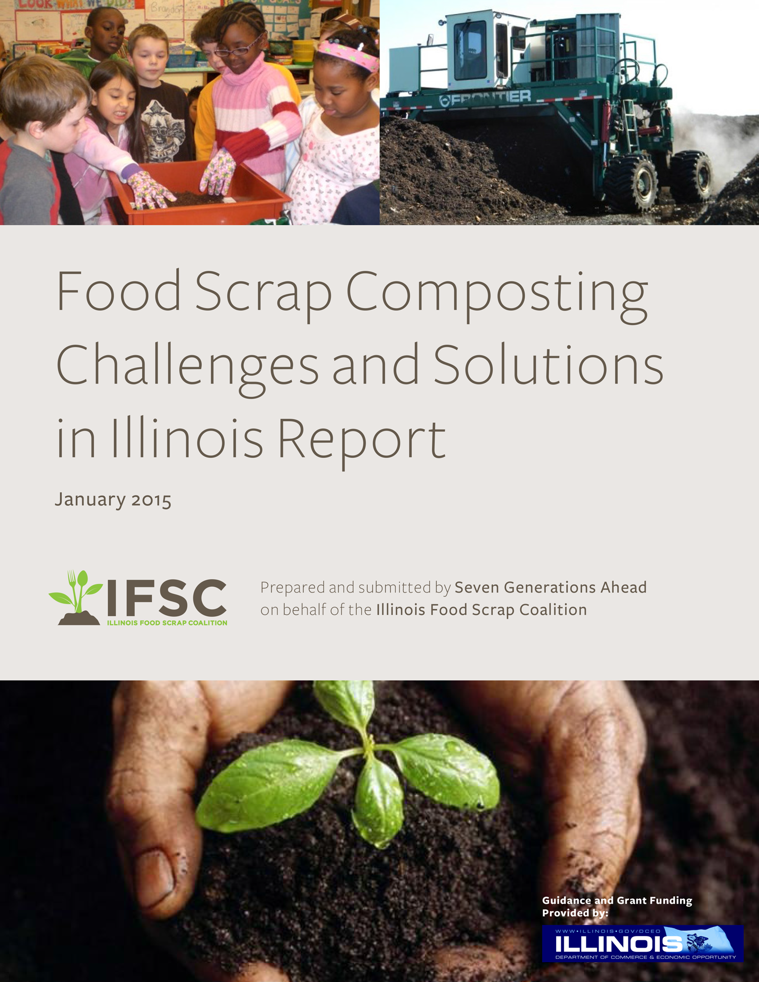
Notes:
SUSAN
In 2014, the IFSC received funding from the Illinois Department of Commerce and Economic Opportunity (DCEO) research national best practices and policies to learn what was working in different parts of the country and why, so that we could best determine what might work in Illinois.
We then took this information on the road to meet with stakeholders to talk about the challenges and possible solutions in Illinois.
Research and stakeholder forums led to the development of the 2015 Food Scrap Composting Challenges and Solutions in Illinois Report. The report laid out 6 key challenges in Illinois, all of which related to a need for education on the benefits of composting and finding a way to make composting at least cost-neutral for everyone from food scrap generators to haulers to compost processors to the end use of finshed compost.
TRANSITION: Since that report, there have been advances in food scrap composting. However, Illinois continues to face challenges with higher cost to compost than landfill and work needs to continue to develop infrastructure and policy to support composting food scraps as a viable option for waste diversion.

Slide 7
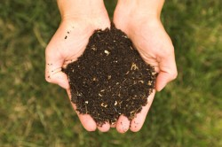
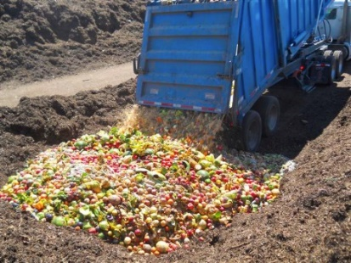
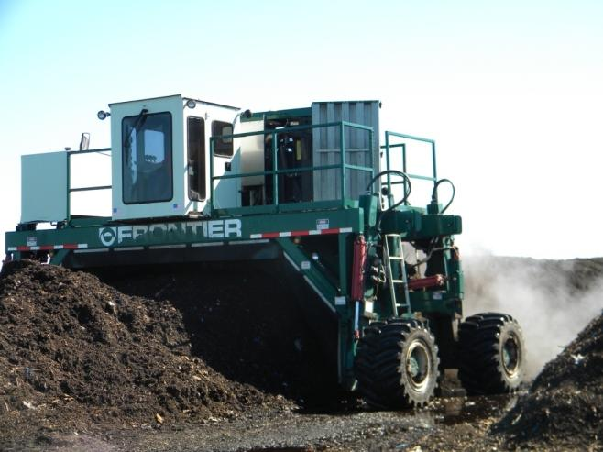
Food: Land: Opportunity Grant
Link
Notes:
SUSAN
One key solution identified in the report was a need for an economic impact study in Illinois to be able to attach dollars to the discussions of food scrap composting.
SGA has received funding in 2016 and 2017 to address this and other solutions identified in the Illinois Food Scrap Composting Challenges and Solutions report. The new funding
ECONOMIC IMPACT REPORT – created last year and being disseminated this year
CONTINUED SUPPORT OF INSTITUTIONS AND BUSINESSES – both through direct logistic support as well as We Compost
SOIL, FOOD, WATER AND COMPOSTING SUMMIT on Nov 3 – Jen J will share details later
WHITE PAPER– being researched and developed with a focus on the AGRICULTURAL USE OF FINISHED COMPOST
TRANSITION: I am going to share with you highlights from the Economic Impact and Market Study Report: Elements for the Case for Advancing Food Scrap Composting Industry and the Link to Building Illinois’ Local Food Economy.

Slide 8
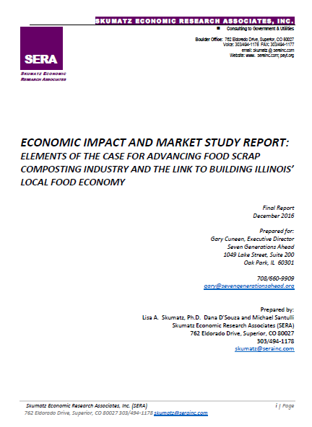
Notes:
SUSAN
Seven Generations Ahead (SGA) contracted Skumatz Economic Research Associates (SERA) to identify the problems associated with landfilling organics, food scraps in particular, and recommend solutions emphasizing the development of the Illinois sustainable food industry.
The goals of the project were to examine the influence of expanded food scraps recovery and composting programs on improving the viability of commercial composting ventures in Illinois, driving Illinois-based food production, and enhancing the local food economy in Illinois, including jobs and revenues.
In order to achieve these goals, SERA:
• Reviewed and analyzed data on food scraps and compostable materials in the Illinois residential and commercial disposal streams.
• Conducted an extensive literature review on current practices, recommendations, and results of state-wide programs and successful community programs. This included multiple reports provided by SGA as well as independent web, interview, and literature research and previous SERA studies.
• Developed programmatic alternatives to recover food scraps and compostable materials from the waste stream, and developed a status quo (or less aggressive) scenario and a higher achieving, more aggressive approach.
• Examined tonnages and market flows affected by the proposed scenarios.
• Conducted interviews with Illinois market actors / stakeholders about market and business effects in food production, composting, and their associated costs from the modeled scenarios.
• Used a well-vetted state and national input/output model to estimate the job and economic output effects of the scenarios (direct, indirect, and induced) based on the data gathered from research, surveys, interviews, and analysis of suitable program and policy scenarios for Illinois.

Slide 9
Projected Benefits
If Illinois can achieve the midpoint organics diversion goal of diverting 65%, this will annually create:
3,185 jobs paying an average salary of $50k
$290 million in economic output for the state
$10.5 million in local and state tax revenue
Over 2 million tons of diversion away from landfills
Over 800k MTCO2e in GHG emissions reduction
Notes:
SUSAN
ORGANICS DIVERSION: food scraps, compostable yard waste (not including woody materials), and compostable paper represent significant recoverable resources. Diverting the three target materials would reduce 22% of tons disposed, and 16% of the MTCO2e available from all the non-recovered recyclables and organics disposed annually in Illinois.
MIDPOINT DIVERSION GOAL: SERA ran three levels of scenarios (low, moderate, and aggressive) which assumed that collection and processing of food scrap increased to 35%, 65%, and 85% of current statewide organics stock. For each of these percentage increases they ran two individual scenarios based on different end-use applications of compost:
• agricultural uses, and
• non-agricultural (i.e. highway remediation) uses
- the benefits shared on this slide represent those achieved if Illinois were to reach the midpoint goal of diverting 65%
- currently about 15% of the combined residential and commercial amounts of material yard waste, food scraps, and compostable paper generated is being diverted
REVIEW PROJECTED BENEFITS
TRANSITION: This report includes great detail about each of these findings and the resulting recommendations. I am only going to share the top level benefits related to Job Creation and State and Local Tax Revenue today.

Slide 10
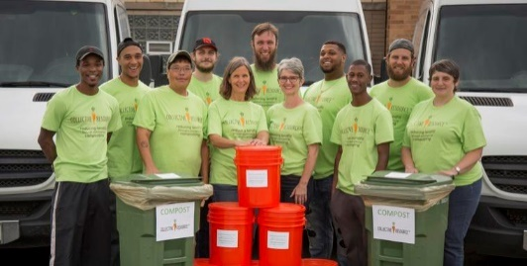
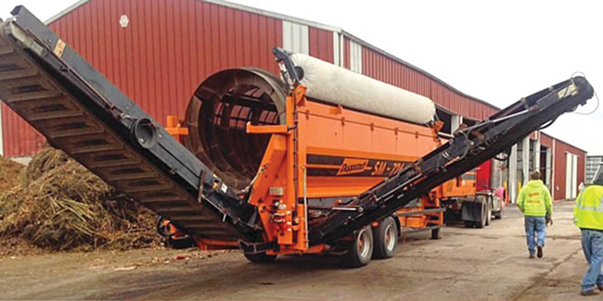
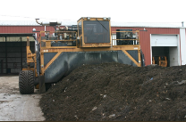
Job Creation
New industries: urban food scrap processors and rural compost spreaders. Opportunities for in-state manufacturing, locally sustained jobs, and increased revenue that will remain within Illinois.
On a per-ton basis, composting in Illinois employs 5 times more workers than landfilling.
For every 12,250 tons of organics processed, 1 new business will be created and will sustain 18.3 employees annually with an average salary of $50k.
Notes:
SUSAN
Job creation is occurring from new industries as well as existing businesses. The images below show IFSC partners Collective Resource and Compost Supply.
On a per-ton basis, composting in Illinois (and across the country) employs 5 times more workers than landfilling.
For every 12,250 tons of organics processed, 1 new business will be created and will sustain 18.3 employees annually with an average salary of $50k
TRANSITION: In addition to benefits from job creation, the sales of finished compost will lead to increased state and local revenue.

Slide 11
Recommended Programs
Program | Description
Tip Fee Incentives | Additional fees (such as a State Solid Waste Fee) added (or raised) on landfilled materials to increase the cost of using this waste stream and make the non-taxed streams, such as composting, more financially attractive.
Diversion goal | Set a statewide diversion goal for compostable material.
“Piggy back” on existing yard waste landfill ban | Adding food scraps as an additional item to the existing yard waste landfill ban to capitalize, or “Piggy-Back” on existing infrastructure.
Pay-As-You-Throw (PAYT) Residential | Volume-based program for trash fees with recycling or organics embedded (included in the trash bill at no additional cost)
:
: :
:
Notes:
SUSAN
Tip Fee Incentives: Additional fees (such as a State Solid Waste Fee) could be added (or raised) on landfilled materials to increase the cost of using this waste stream and making the non-taxed streams, such as composting, more financially attractive.
Diversion goal: Set a statewide diversion goal for compostable material.
“Piggy back” on existing yard waste landfill ban: This involves adding food scraps as an additional item to the existing yard waste landfill ban to capitalize, or “Piggy-Back” on existing infrastructure.
Pay-As-You-Throw (PAYT) Residential: This is a volume-based program for trash fees with recycling or organics embedded (included in the trash bill at no additional cost). The more material diverted from trash, the smaller sized trash container can be used, lowering the trash bill

Slide 12
State and Local Tax Revenue
2015 (15% of organics composted)
Compost sector is adding $35 million in value to Illinois state economy
Projected revenue for 35-85% of organics composted
Local and state level total tax revenues would increase by a range of $3 million - $13.6 million
Federal tax revenue would increase by a range of $16 million - $42 million
Notes:
SUSAN
Review revenue listed on slide…
As of 2015, the compost sector is adding $35 million in value to the Illinois state economy: the current level is only 15% of the estimated potential value of this industry.
The majority of the value added would be received by the compost industry; however, the model results show that the ripple effects of such programs would reach a majority of active economic sectors in Illinois, thereby improving living conditions for people of all walks of life within the state.
In addition to general economic output, the model shows that pursuing these food scrap composting programs has significant impacts on local, state, and federal tax revenue.
• On the local and state level, total tax revenues increased by a range of $3 million - $13.6 million for the different scenarios.
• Total federal tax revenue increased by a range of $16 million - $42 million for the different scenarios.
These increased tax collections are not game-changers as far as total government revenues, but they do represent opportunities to recirculate tax money back into the industries from which it was generated and bolster, both short- and long-term, market development through the funding of grant programs.
TRANSITION: How do we take advantage of the environmental and economic opportunities with food scrap composting? As in other states, farmers in Illinois operate on a very small profit margin. Therefore, agricultural demand for locally-produced compost would not be expected to increase until using this product makes farms more competitive with other farms still using traditional chemical fertilizer. Illinois needs to develop infrastructure and policy to support food scrap composting so that this becomes cost competetive.

Slide 13
Final Report Findings for Illinois
Barrier | Needed Change
Lengthy and expensive permitting process | Simplifying the permitting process for food scrap composters
Low end-use demand particularly in agricultural sectors | Driving the local economic engine by increasing small-scale farmer demand for compost as an agricultural product.
Notes:
SUSAN
There are two major barriers and recommendations for industry development. Based on extensive literature review, structured interviews, data analysis and input-output modeling, the composting industry in Illinois faces two main industry barriers.
A lengthy and expensive permitting process
Low end-use demand in agricultural sectors for finished compost
The strategy recommendations consist of two main elements – diversion options, and use options (demand, and supply-side elements). The most critical areas of focus for the state of Illinois in further developing the composting industry are: simplifying the permitting process for food scrap composters, and driving the local economic engine by increasing small-scale farmer demand for compost as an agricultural product.
This report offers detailed background information as well as recommendations. I encourage you to read at least the Executive Summary. The report is available to download on both the Illinois Food Scrap Coalition and the Seven Generations Ahead websites. If your county is looking into food scrap composting and would like to have a more in depth discussion of this report, please contact Seven Generations Ahead.
TRANSITION: I will now turn it over to Walter to talk about ways in which the IFSC is working to develop an end market for finished compost in Illinois.

Slide 14
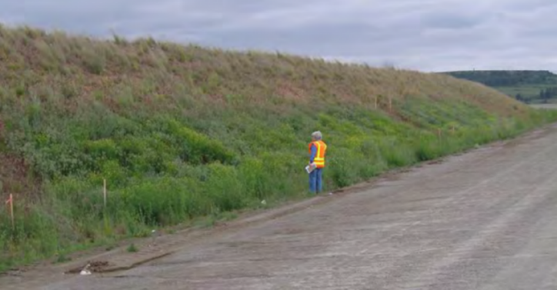
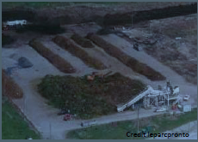
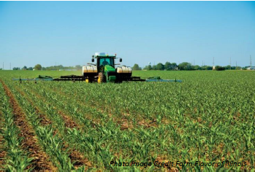
End Market Development
Market Development Committee is a standing committee of the IFSC
Diverse membership including compost site operators, NGO, haulers, golf course operator, and solid waste agency
Key to food scrap diversion growth in IL is more markets, more markets, more markets. . .
Notes:
Walt -

Slide 15
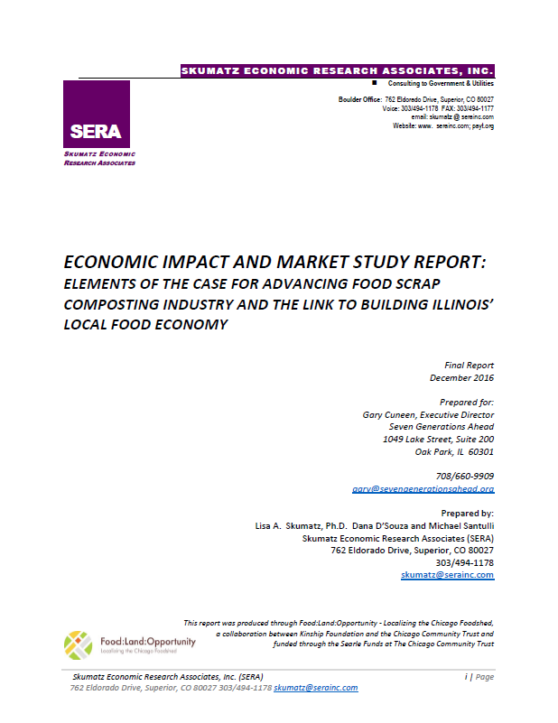
End Market Development
Market Committee is focused on market development for ALL compost products, not just food scrap amended compost
Market growth is tied to job and economic growth, Dec. 2016 Market Impact and Market Study Report found that a 65% organics diversion goal would:
Create 3,185 jobs
Generate $290 million in economic output
Divert over 2 million tons annually from landfilling
Notes:
Walt -

Slide 16
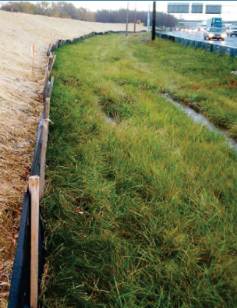
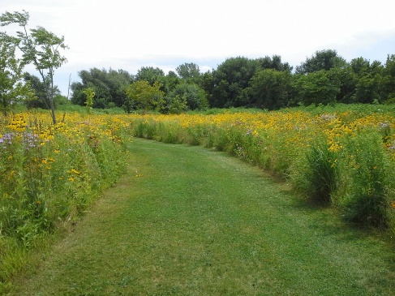
End Market Development
Formed three subcommittees:
Major Market – focused on large markets, primarily transportation projects, and agriculture uses
Municipal, Local Agency and Organization – focused on more distinct markets related to municipal projects including roads and public works projects, and local agencies and organizations such as park districts, golf courses, and schools
Composter – focused on better organizing data and information on the supply side (the final compost product) of the equation, must understand the type and amount of compost product we have in order to better market it to users
Source: www.idot.illinois.gov
Source: www.encapinc.net
Source: Compost Supply
Notes:
Walt -

Slide 17
End Market Development
Accomplishments to date:
Developing survey to administer to IL farmers to assess current use of compost, barriers to its use, and interest of farmers in learning more
Developing a survey to administer to IL golf courses to assess current use of compost, barriers to its use and interest in learning more
Constructed a table top display for final compost products for use at conferences, farmers markets, and similar events
Notes:
Walt -

Slide 18
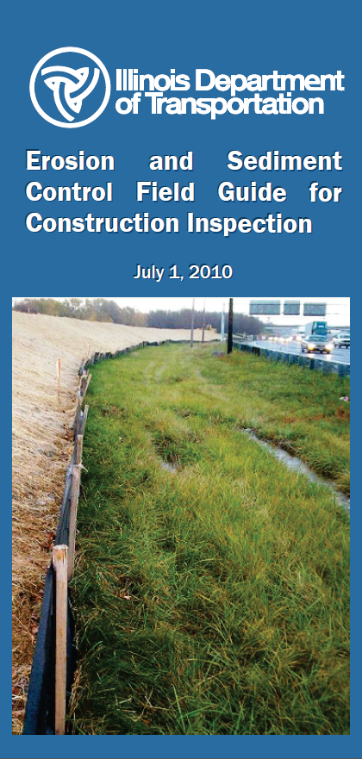
End Market Development
Accomplishments to date:
POLICY: Worked with Rep. Sente and legislation she introduced to prompt voluntary action from IEPA and IDOT to assist with market development
DATA: IEPA’s annual report for compost site operators now includes a question regarding acceptance of food scraps, key to knowing which of the 43 IEPA permitted compost sites accept food scraps
END MARKET CUSTOMER: IDOT met with IFSC members in April 2017 to discuss incorporating compost into road construction projects; provided IDOT with information from other state DOTs that are using significant amounts of compost, including WA, TX, CA and MN
Notes:
Walt -

Slide 19
End Market Development
Goals:
Conduct several projects with IDOT to show the benefits of using soil blends with compost to more effectively and economically grow vegetative covers
A Google Map is being developed showing all permitted compost sites in the State, with relevant contact information, compost volumes, website links, etc., which will help with connecting IDOT road projects with nearby compost sites.
Notes:
Walt -

Slide 20
IFSC Partners with USCC
IFSC Board has agreed to join the U.S. Composting Council as a State Organizational Committee, the first step in becoming a State Charter Chapter
End Market Committee agrees that USCC’s Seal of Testing Assurance (STA) should become the primary standard for compost sites to meet to ensure a quality final product
IFSC Board sees the value of USCC in helping with market development in IL, as market development is a key goal of the USCC
Notes:
Walt -

Slide 21
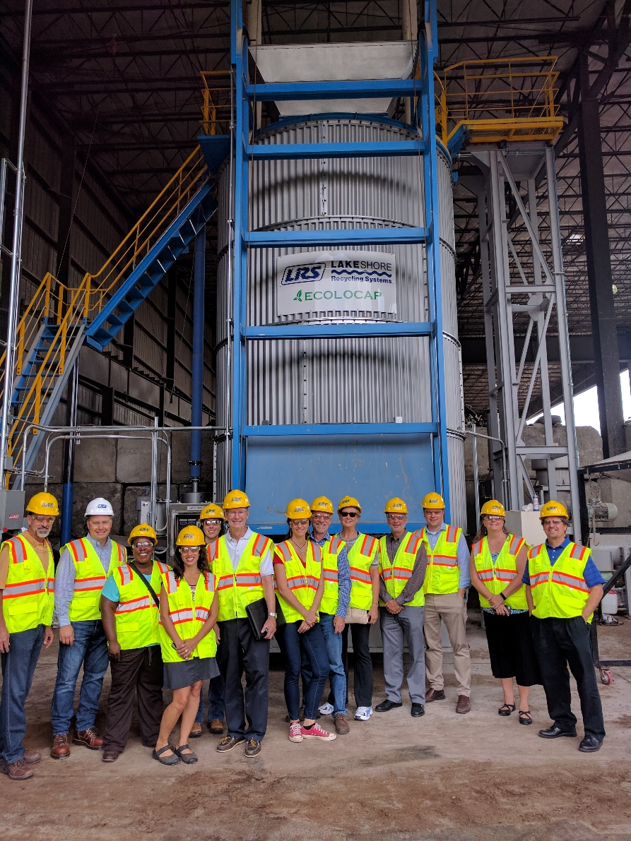
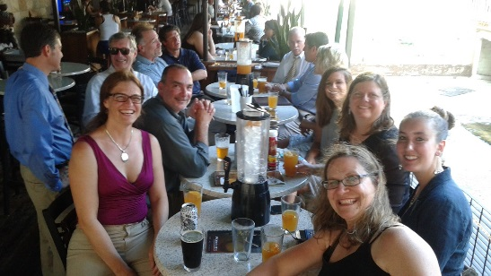
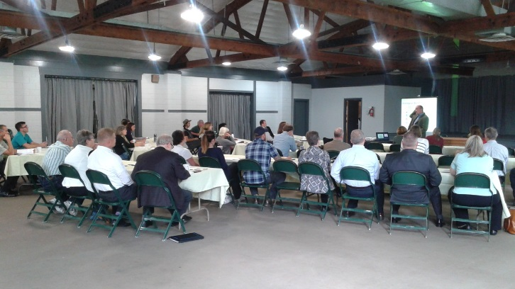
Join IFSC
Membership: Individual $50, Organization $150 (3 people)
Partnership: Silver $500 Gold $1000 Platinum $3000
illinoiscomposts.org/join
Notes:
Jen J
Please join us in paving the way for broader infrastructure, successful and cohesive programs, more diversion of food scraps, and widespread participation in all sectors. And we have fun along with all the work that needs to be done. The photos are from some of the tours, forums and social gatherings we’ve had over these inaugural years.
Easy to join, go to website and click on join. It is a two step process, please fill out the application form and submit it and then pay by clicking the paypal link provided.

Slide 22
Notes:
JEN J
Please see the attached flier for the Illinois Soil, Food, Water & Composting Summit. We encourage you to ATTEND and to FORWARD to your colleagues who are working to improve Illinois water and soil quality, local sustainable food, composting and food recovery outcomes. Registration link: https://sevengenerationsahead.org/zero-waste-stories-from-the-field/illinois-soil-water-food-and-composting-summit.
Summit Purpose: To bring together leaders and practitioners working on soil conservation, water quality protection, sustainable agriculture/local food, food recovery and composting to learn more about the connectivity between issues and explore opportunities for collaborative work that lead to soil conservation and enhancement, increased water quality, greater availability of local food for local consumption, increased waste diversion, composting and food recovery, and economic development opportunities.
_____________________________________________________________________________________________________
Summit Audience:
Universities; Soil and Water Conservation Districts; EPA; Composting stakeholders/advocates; Local, sustainable food and agriculture and composting stakeholders/advocates; Farmers; Food Recovery leaders/advocates; IDOT; Golf Course operators; Environmental organizations; Water quality protection advocates; Municipal and county governments; State legislators; private sector leaders; funding agencies.

Slide 23
Follow IFSC
Website: illinoiscomposts.org
Blog: http://illinoiscomposts.org/ifsc-blog
Facebook: facebook.com/IllinoisFoodScrapCoalition
Twitter: twitter.com/ILComposts
YouTube: youtube.com/user/IllinoisFSC
LinkedIn: linkedin.com/groups/8365760
Thank you to our 2017 IFSC Sustaining Partners
Notes:
Jen J
Wrap up
Transition to Michelle

Slide 24
Thank You
For more information, or to get in contact with any of today’s speakers:
Liz Bosarge illinoiscomposts@gmail.com
Susan Casey susan@sevengenerationsahead.org
Walter Willis wwillis@swalco.org
Jennifer Jarland JarlandJennifer@co.kane.il.us
Michelle Gibson MGibson@dekalbcounty.org

Slide 25
Q & A
Notes:
Jen J

